Slide 1

Guided Capstone Slide Deck
Big Mountain Resort

Slide 2
Problem Identification
Big Mountain Resort problem identification has two broad classifications:
A $1.54m operational cost due to an additional acquisition of a chair lift.
Means of possible revenue increment through introduction of a premium charge above the average price of resorts in its market segment.

Slide 3
Recommendation and Key Findings
Recommendation includes:
Big Mountain Resort can adopt a suggestive ticket price within the range of $85.48 and $106.46, based on $95.87 modelled price with expected mean absolute error of $10.39
The Resort should use its discretion since ticket price is not determined by any set of parameters; it can freely apply whatever price it chooses according to what the market supports.
Considering facilities being offered, Big Mountain Resort should add a Run, increase Vertical drop by 150 feet and an additional chair lift installation.
Key Findings:
Recommendation bullet point 3 increases support for ticket price by $1.99
And an expected revenue generation of $3,474,638 over the season assuming an anticipated number of 350,000 visitors for the same season, each purchasing 5 tickets.
Closing on Run does not affect Ticket price and Revenue; but closing 2 and 3 Runs reduces support for ticket price and revenue. However, increasing the closures down to 6 or more would cause Big Mountain a large drop.

Slide 4
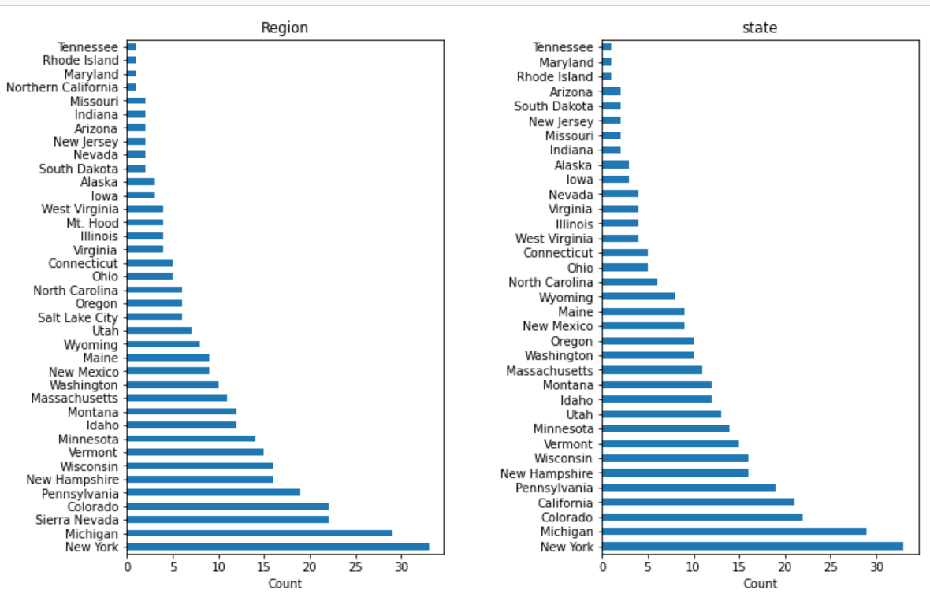
Modeling Results and Analysis
Data Wrangling:
Essential Python Libraries were imported.
Ski Resort data set were loaded, including checking summary of the data: 330 entries on columns and 27 rows.
Find the Resort of interest, Big Mountain Resort, which contained no missing values.
The number of missing values by columns were evaluated and those with high percent of missing values were dropped.
Categorical features were examined. These are resort name and state, which are discrete entities.
Here is the resort distributions:

Slide 5
Modeling Results and Analysis Continues……
Overall wrangling indicates 82% of the resorts have no missing ticket pricing. 14% of the resorts with missing values were discarded.
Silverton Mountain Resort has spurious value of 26,819 Skiiable Terrain ac instead of 1819. Corrected.
Heavenly Mountain Resort(row) was dropped because it has no ticket pricing.
FastEight column has 163 zero values and has no relevant information. Discarded too.
AdultWeekday column contains several missing values as seen in the state of Montana. The row is dropped while AdultWeekend is applied in the modeling
Total structure of the ski_data is 277 rows and 25 columns with some dtypes.

Slide 6
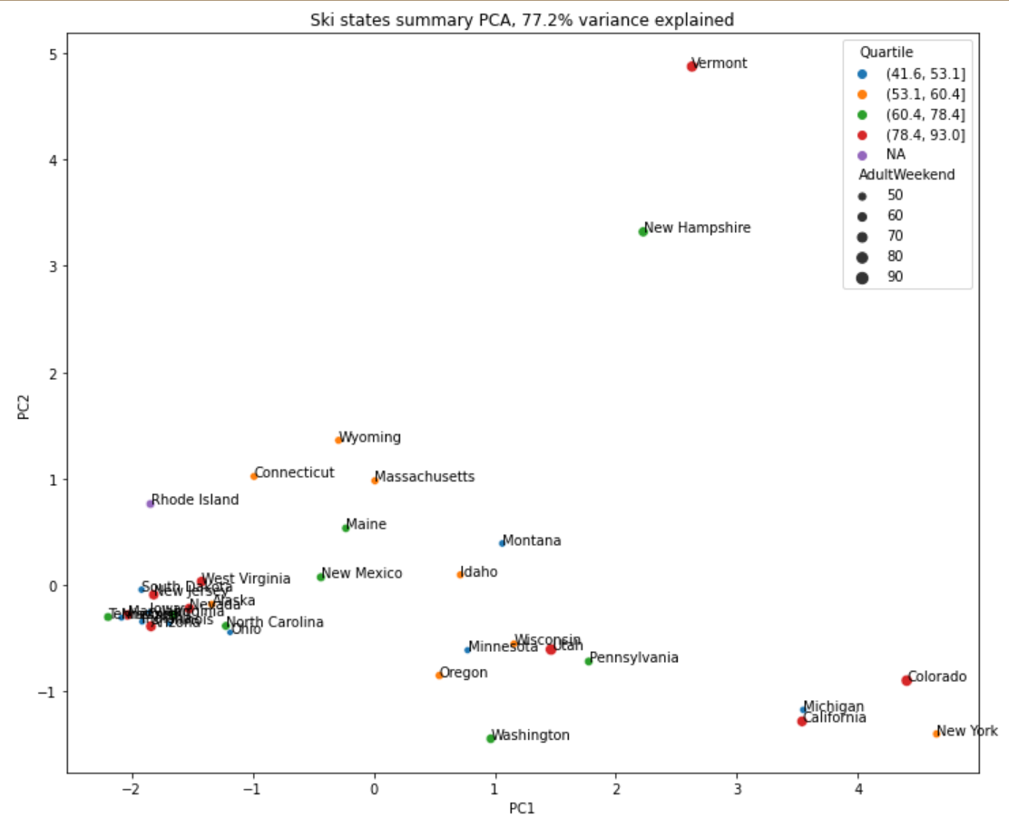
Modeling Results and Analysis Continues……
Next is EXPLORATORY DATA ANALYSIS
Purpose here is to predict the AdultWeekend ticket price for ski resorts.
Augment the ski data set with US state population and size data, which gives total state area, total state population, Resorts per state, total skiable area, total night skiing area, total days open, resort density (Montana being among the top 5).
Principle components analysis is used to explore how original features contribute to these derived features; involves scale the data, fit the PCA transformation, apply transformation to the data to create derived features, then seek for patterns in the data and explore the coefficients.
Ski summaries for each state, accounting for some 77.2% of the variance.
Scatterplots of numeric features against ticket price, where correlation as aheat map identify patterns.
AdultWeekend ticket price correlates with fastQuad, Runs, snow making acres,
Resort night skiing state ratio, total chairs, vertical drop. These would be market strategies that can raise ticket price

Slide 7
Modeling Results and Analysis Continues……
It is same with resorts_per100KCapita as teeming population indicates population for skiing with high demand.
Preprocessing and Training Data:
Here, ski_data was split into train and test in ratio of 7:30 resulting in 193.2:82.8
R²⁻ coefficient of determinant is zero for a baseline model when residual variance equals original variance.
When R²⁻ is 1, a good model with observed values having no residual error.
Imputation was applied to impute missing values.
Using Sklearn’s Random Forest Regressor, pipeline was defined, then applied the fit and assess the performance with Cross Validation followed by Hyperparameter search using GridSearchCV
The result was that the first four features (FastQuad, Runs, snow making ac, vertical drop) were the same as previous linear model
The performance of Random Forest on the test set shows consistency with Cross Validation
Modeling:
Model for ski resort ticket price is leveraged to gain some insights into what price Big Mountain’s facilities might support.

Slide 8
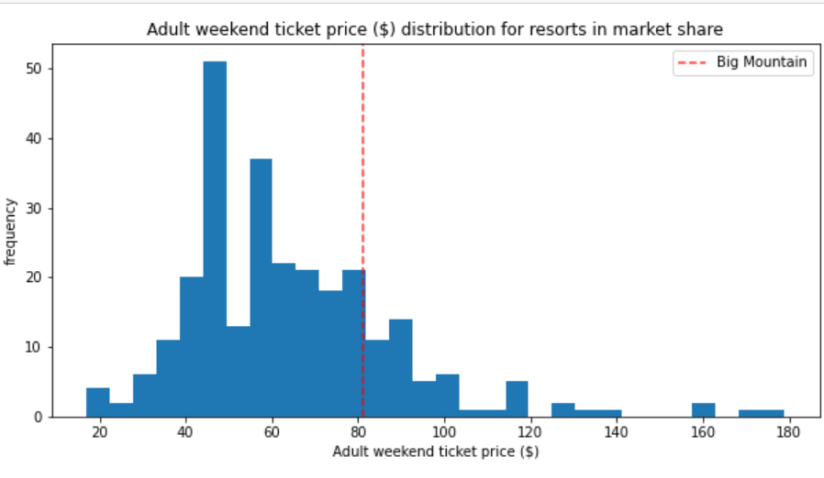
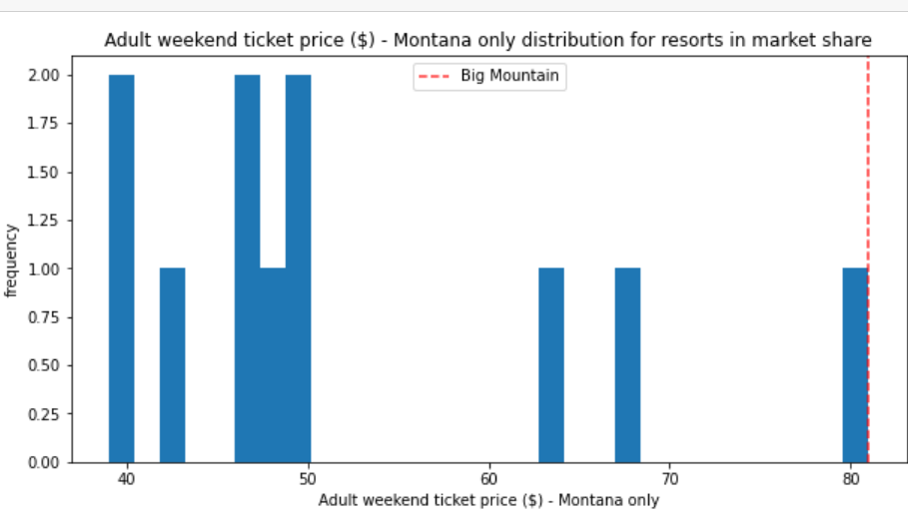
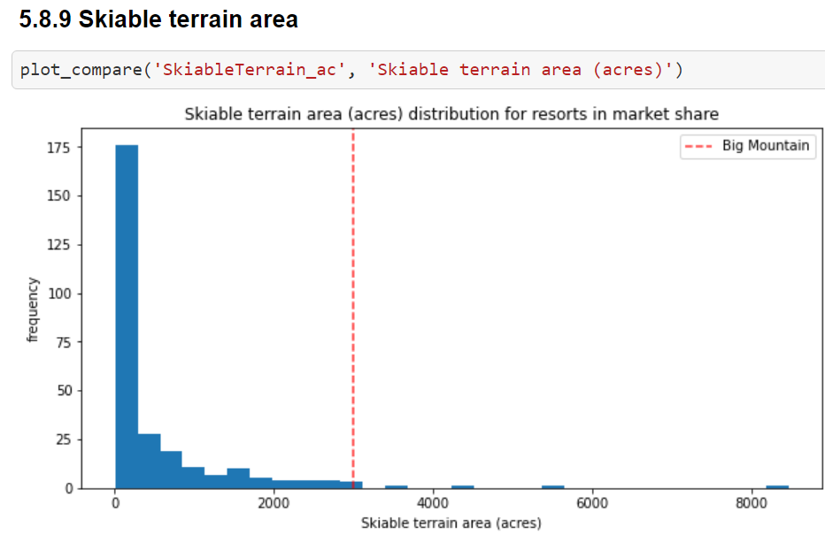
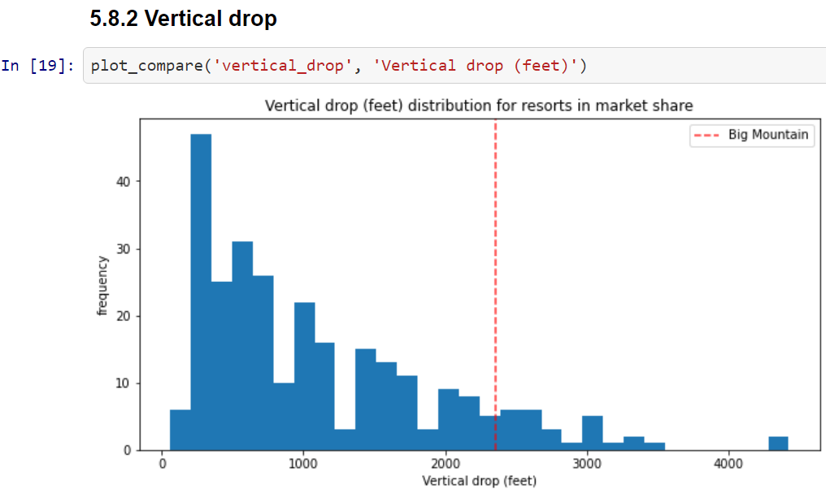
Modeling Results and Analysis Continues……
We train a model to predict Big Mountain’s ticket price based on data from all other resorts.
Big Mountain price is determined based only on its competitors
Big Mountain Resort modelled price is $95.87 while actual price is $81.00 with expected mean error of $10.39. Possibly indication of a hike.
Top left to right show AdultWeekend ticket price distribution for resorts in market share and Montana only distribution for resorts in market share. Redline is Big Mountain.

Slide 9
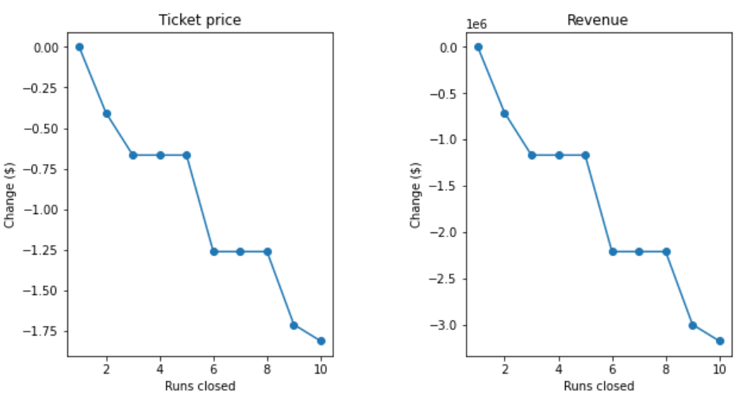
Modeling Results and Analysis Continues……
Bottom left to right (figure above) indicates skiiableterrrain are distribution for resorts in market share and vertical drop (feet) distribution for resorts in market share. Redline is Big Mountain.
For Big Mountain to slice costs or increase revenue from ticket price, the following expected visitors to 350,000; vertical drop increased up to 10 of the least used runs; vertical drop increased by 150 feet, with an additional chair lift installation; then increasing the LongestRun to 3.5 miles length by adding 0.2miles to its original length.
Figure below demonstrates closing 1 run makes no impact; 2 and 3 closures successively reduce support for ticket price and revenue. If Big Mountain closes down 3 runs, it can close 4 or 5 no further loss in ticket price. Down to 6 or more leads to a large drop.
For a Run, 150 feet vertical drop and additional chair lift, this would give support for ticket price increase by $1.99 and an expected amount $3,474,638 in revenue. Adding 2 acres of snow making produces the same result, that is the small increase in snow making does not produce a change.

Slide 10
Summary and Conclusion
Summary:
Random Forest of Sklearn stands as the best model that compared ski resorts ticket prices based on the facilities they offered to ski market segment, which facilitated a ticket price increase for Big Mountain Resort at mean absolute error of $10.39. The result is a revenue generation of $3,474,638 over the season assuming 350,000 visitors and each expected to purchase 5 tickets.
Conclusion:
Big Mountain Resort can implement ticket price increase between $85.48 and $106.46 based on the $95.87 model ticket price. And a resulting revenue of $3,474,638 ensured, which would offset the cost of operation of the newly added chair lift and other operational costs.

